Slide 1

Naukri Jobs Data Web Scrapping & Analysis

Slide 2
About me
Name: Bodasingi Anil Kumar
Qualitification: Mtech BITS Pilani Rajasthan
Why Data Science ?
The future has immense impact on data
Through data analysis we can make accurate predictions, conclusions
Securing Data & key sensitive information
Any work experience
Working in IBM from last 3 years
Share your linkedin and github profile urls –

Slide 3
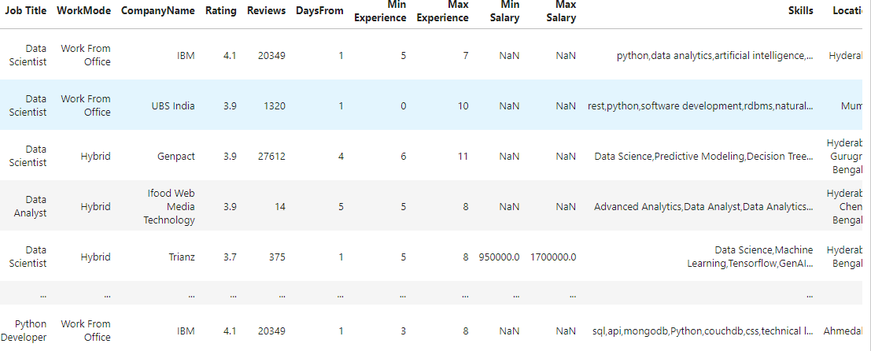
Agenda
Objective of the Project
The objective of this project is to scrape job details from Naukri.com, a popular job portal in India, and analyze the data to gain insights into job trends and market demand.
Website : https://www.naukri.com/
Process followed for scrapping:
Used Selenium: A web automation tool used for scraping dynamic web pages.
Python libraries for Data Cleaning & Data Analysis with various approaches
Extracted Raw data from Naukri website and saved in Naukri_RawData.csv
Summary of the Data

Slide 4
Agenda
Summary of the Data
Scrapped the 80 pages on live website
Raw data contains 1600 rows & 7 columns
Post data cleaning & manipulation the size of the data frame is 1580 rows & 13 columns
The number of column data types are float64(3), int64(4), object(6)
Exploratory Data Analysis:
Data Cleaning Steps
Used Pandas for reading raw data with required columns.
Used Regex to identify the patterns and split the raw data into multiple columns
Normalized the duplicate values in columns with pandas & regex
Dropped the unrelated columns & rows
Created Naukri_DataCleaning.csv file
Data Manipulation Steps
Converted the datatype of the data frame column to int and float
Filled null values with appropriate values . E.g., Ratings & Review columns
Used custom methods & built in methods to get desired values
Created Naukri_DataAnalysis.csv file for all plots and analysis

Slide 5
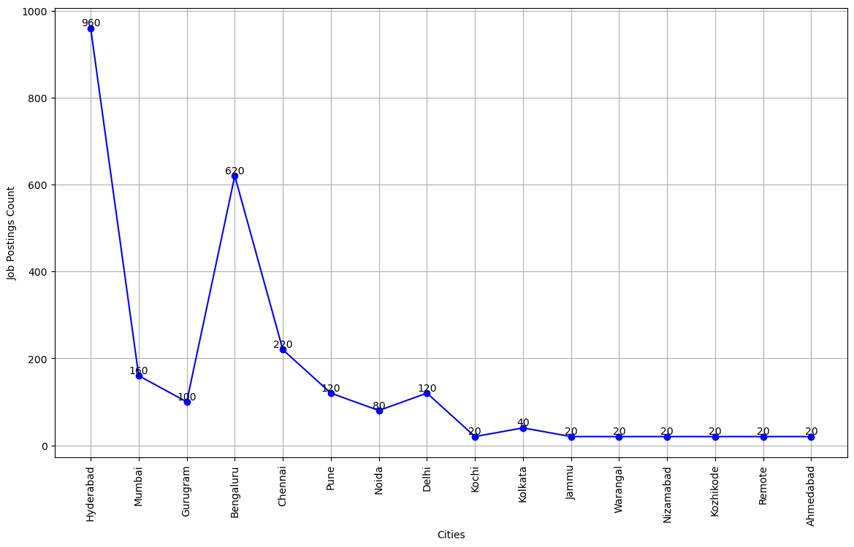
Univariate Analysis
Line chart on Job Vacancies on across all Locations
Hyderabad has the highest number of job postings.
The number of jobs in Bengaluru is lower than in Hyderabad but higher than in other cities.
Chennai, Gurugram, and Mumbai offer a moderate number of job opportunities.
Plotting the line chart on all locations

Slide 6
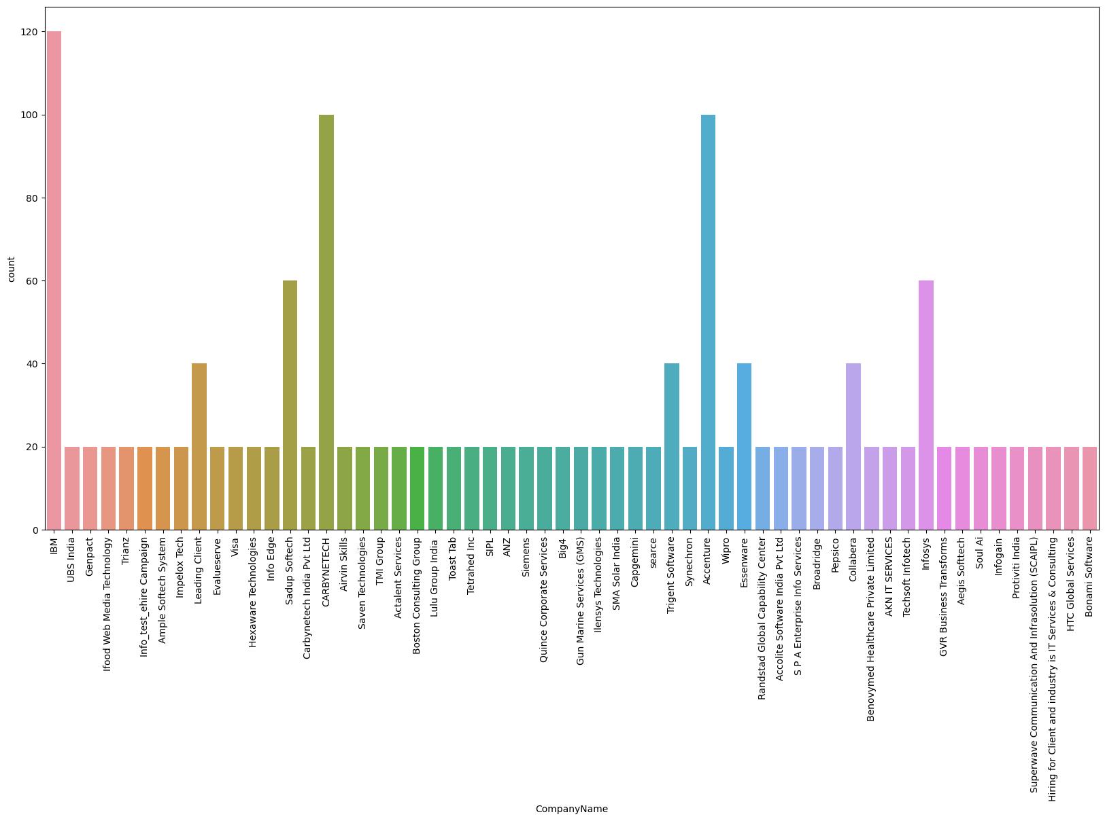
Univariate Analysis
Plotting Bar chart on All companies
IBM has the highest number of vacancies.
The number of vacancies in
Accenture & CARBYNETECH are
lower than in IBM but higher than
in other companies.
Infosys, sadup, Trigent had
a moderate number of job opportunities.
Plotting the line chart on all locations

Slide 7
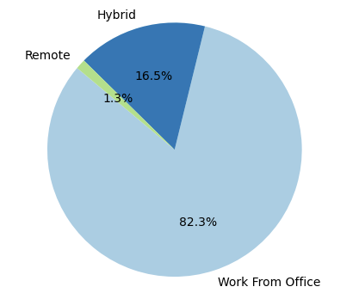
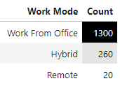
Univariate Analysis
Pie Chart on Work Mode
Maximum opportunities are for Work From office mode
The number of opportunities for Hybrid mode is moderate.
Very few opportunities for remote

Slide 8
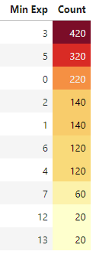
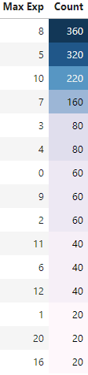
Univariate Analysis
Table View on Max & Min Experience
For 8 years experience candidates more opportunities
For 5 years experience candidates moderate
For Freshers opportunities are moderate
For high experienced candidates opportunities are less
For 3 years experience candidates more opportunities
For 5 years experience candidates moderate
For Freshers opportunities are moderate
For high experienced candidates opportunities are less
Conclusion:
For 3- 8 years more number of opportunities in market
For above 15 + years of experience very less opportunities

Slide 9
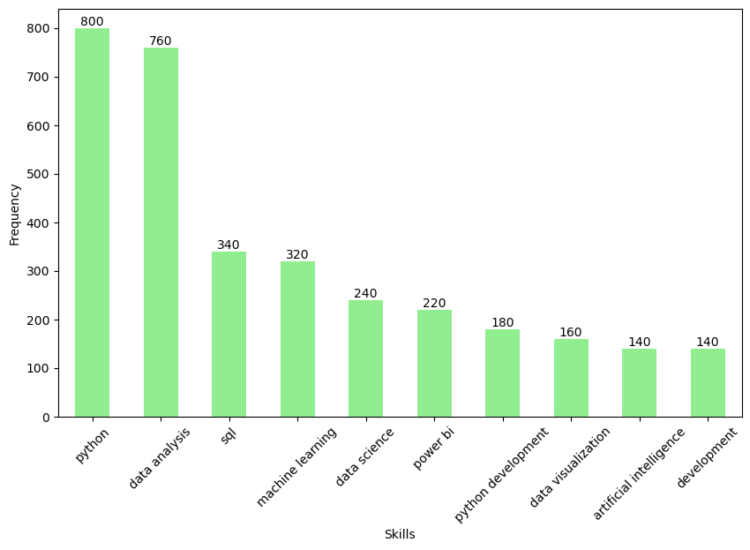
Bivariate Analysis
Bar Chart on Most Demanding Skill in Market
Python Dominance & most demanding skill which is required for maximum of jobs
Data Analysis & Analytics are strong Emphasis on Data Skills
SQL & Machine learning is also Important skill

Slide 10
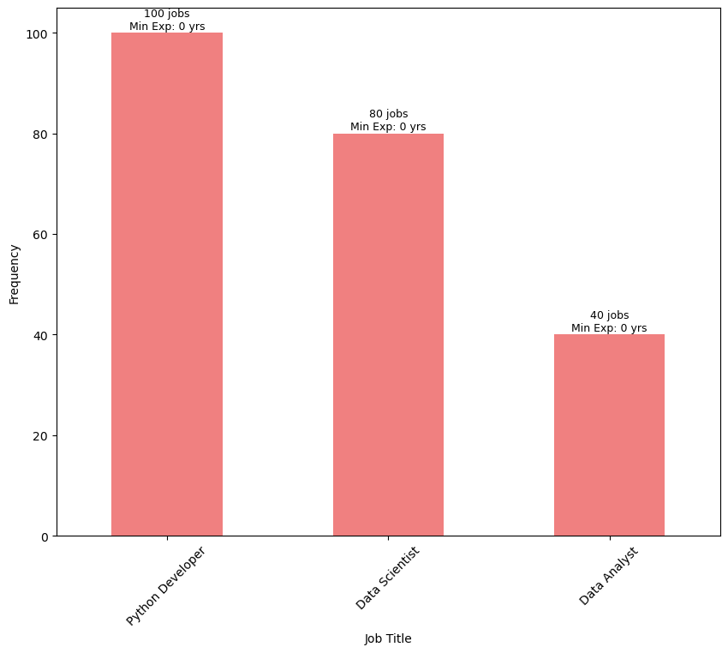
Bivariate Analysis
Demanding Jobs with Minimum Experience
The Top 3 jobs roles for freshers as shown in image
Highest Python developer jobs are available with 0 experience
Opportunities for DS students (with 0 experience) are moderate
Only few jobs are available for Data Analyst with 0 experience

Slide 11
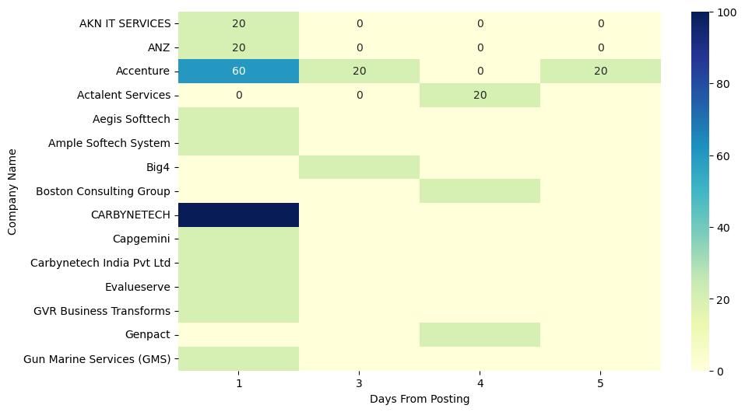
Bivariate Analysis
Heatmap on Job Postings by Company in the Last 3 Days
Highest jobs are posted by Carbynetech company
Accenture posted jobs are higher then others and lower than Carbynetech
Other companies posted jobs are very less Max Salary vs. Max Experience

Slide 12
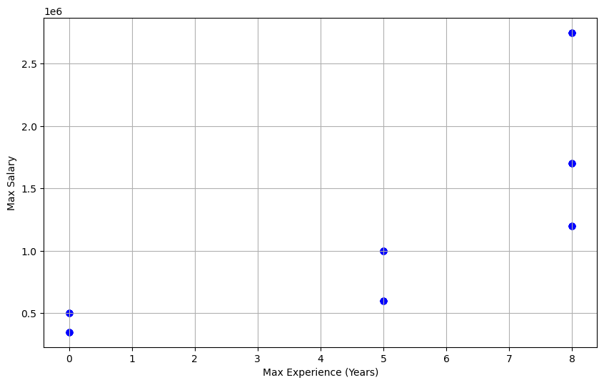
Bivariate Analysis
Scattered plot on Max Salary vs. Max Experience
Max Experience candidates will get Max Salary
Low Experience candidates will get low salary

Slide 13
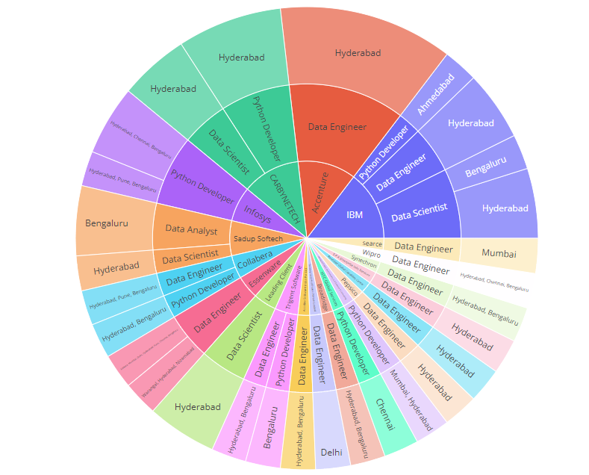
Bivariate Analysis
Sunburst Chat on Top 20 Companies
Sunburst Chart: Company Name -> Job Title ->
Locations with Job Count'

Slide 14
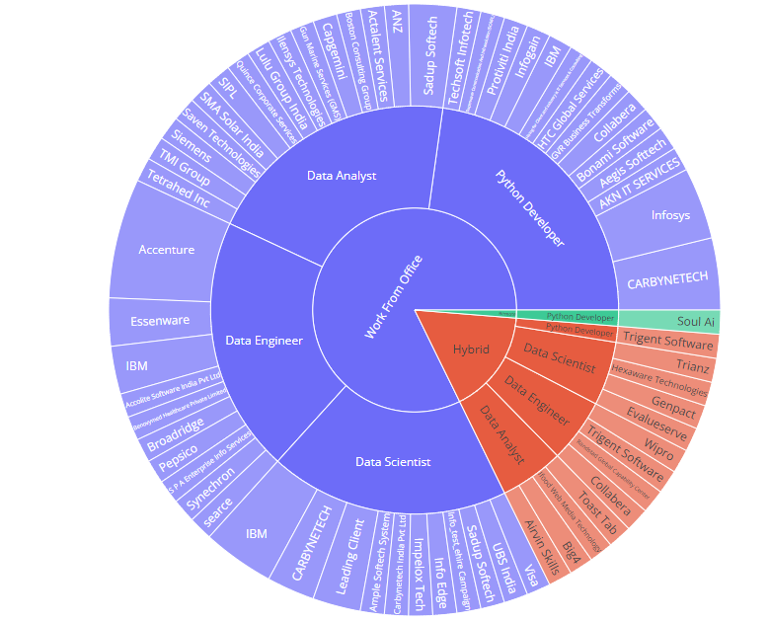
Bivariate Analysis
Sunburst Chat on Top 20 Companies
Maximum number of jobs available only for Work from Office
Only one company is offering Remote job
company name: Soul Ai

Slide 15
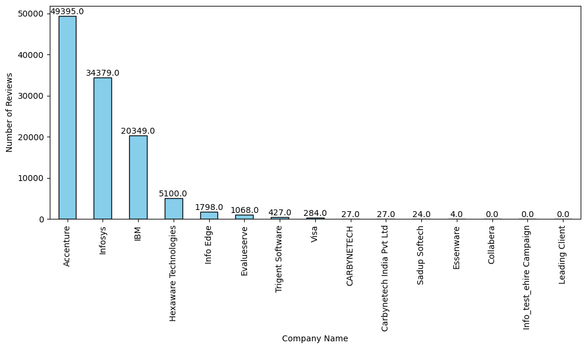
Bivariate Analysis
Bar Chart on Reviews of Top 15 Companies
Maximum reviews are written to Accenture
The number of Infosys & IBM reviews are moderate.
There are few companies which has no reviews

Slide 16
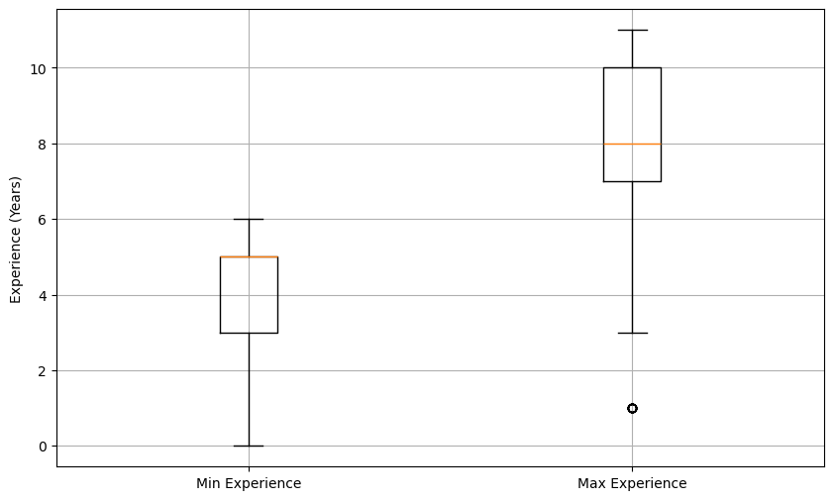
Bivariate Analysis
Scattered plot on Max Salary vs. Max Experience
In Max experience there is one outlet
(1 Year experience )

Slide 17
Key Business Question:
Most demanding skill is Python
Python Developer, Data Scientist, Analyst, Data Engineer jobs are more essential
Most Demanding job with minimum (0) experience is python developer
Data Scientist can earn maximum salary (10 LPA) with minimum (0) experience
Conclusion
Total unique companies are 58
58 unique companies offering 1580 jobs across 28 different locations
3 models of work i.e, WFO, Hybrid & Remote
Challenges
Hidden data extraction.
Splitting columns based on Regex patterns
Data cleaning & manipulation
Analysing & providing insights on real time data

Slide 18

THANK YOU

